Slide 1

An open-source solution for collaborations, prototyping and innovation in simulation
Innovation catalyst in medicine and robotics
Notes:
Preparer :
SOFA
GitHub
Sofa-framework + applications/plugins
Doc : supported plugins
Video Links
-----------
Cryo / python: https://www.youtube.com/watch?v=VJNjgc13ypE&list=PLL2-UDGHPj0gT2F4O4Pe0kS05Qi3A49jY&index=34
Reset / haptics: https://www.youtube.com/watch?v=Fkizj7QVYSw&list=PLL2-UDGHPj0gT2F4O4Pe0kS05Qi3A49jY&index=30
Endoscopy
https://www.youtube.com/watch?v=gcTD9UHvebc&list=PLL2-UDGHPj0gT2F4O4Pe0kS05Qi3A49jY&index=169
Electrophysiology
https://www.youtube.com/watch?v=-7pwUDalBlg&list=PLL2-UDGHPj0gT2F4O4Pe0kS05Qi3A49jY&index=53
Cataract InSImo
https://www.youtube.com/watch?v=kE33G0awe_0&list=PLL2-UDGHPj0gT2F4O4Pe0kS05Qi3A49jY&index=38
Anatoscope
https://www.youtube.com/watch?v=ry4ORSEmz8U&list=PLL2-UDGHPj0gT2F4O4Pe0kS05Qi3A49jY&index=44
AR: https://www.youtube.com/watch?v=fH_RD3p4vMM&list=PLL2-UDGHPj0gT2F4O4Pe0kS05Qi3A49jY&index=6
Softrobot 1
https://www.youtube.com/watch?v=J3wVr3iv6eY&list=PLL2-UDGHPj0gT2F4O4Pe0kS05Qi3A49jY&index=92
Softrobot 2 (touchpad)
https://www.youtube.com/watch?v=uFyHFItwnHI&list=PLL2-UDGHPj0gT2F4O4Pe0kS05Qi3A49jY&index=141&t=14s
MOR
https://www.youtube.com/watch?v=2MxzqrpQO9o&list=PLL2-UDGHPj0gT2F4O4Pe0kS05Qi3A49jY&index=151
UEngine
https://www.youtube.com/watch?v=OMAFOoxVDIQ&list=PLL2-UDGHPj0gT2F4O4Pe0kS05Qi3A49jY&index=152
Machine Learning
https://www.youtube.com/watch?v=KcAM4r4G6gI&list=PLL2-UDGHPj0gT2F4O4Pe0kS05Qi3A49jY&index=161

Slide 2

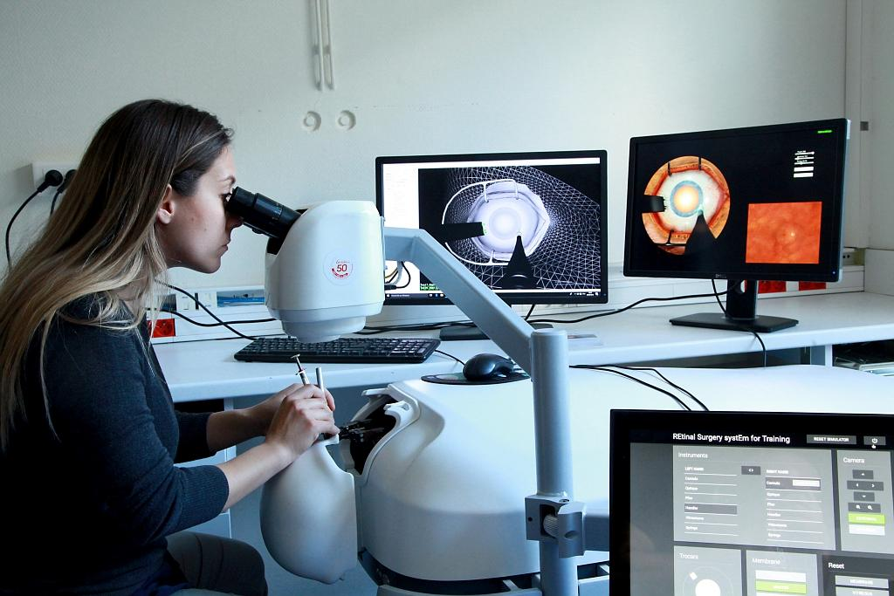
Overview
Discover SOFA
Community and project governance
Main principles of the framework
Simulation features
How to get started / Take home message

Slide 3
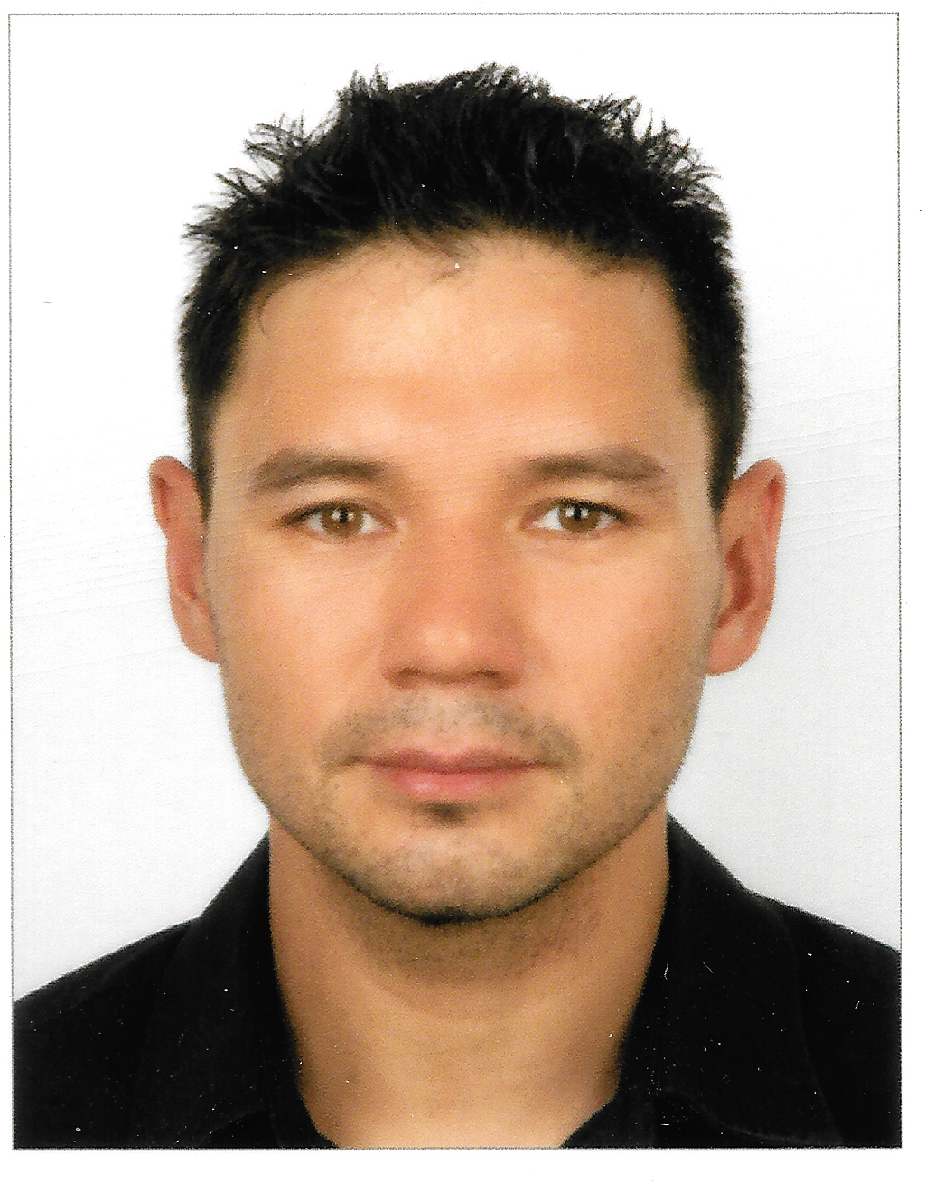
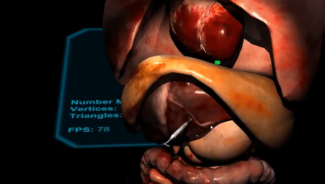
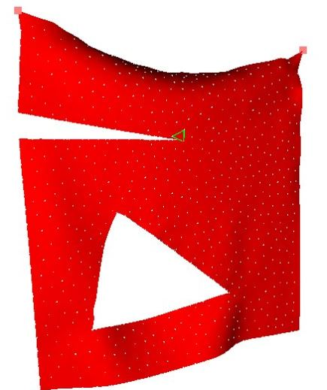
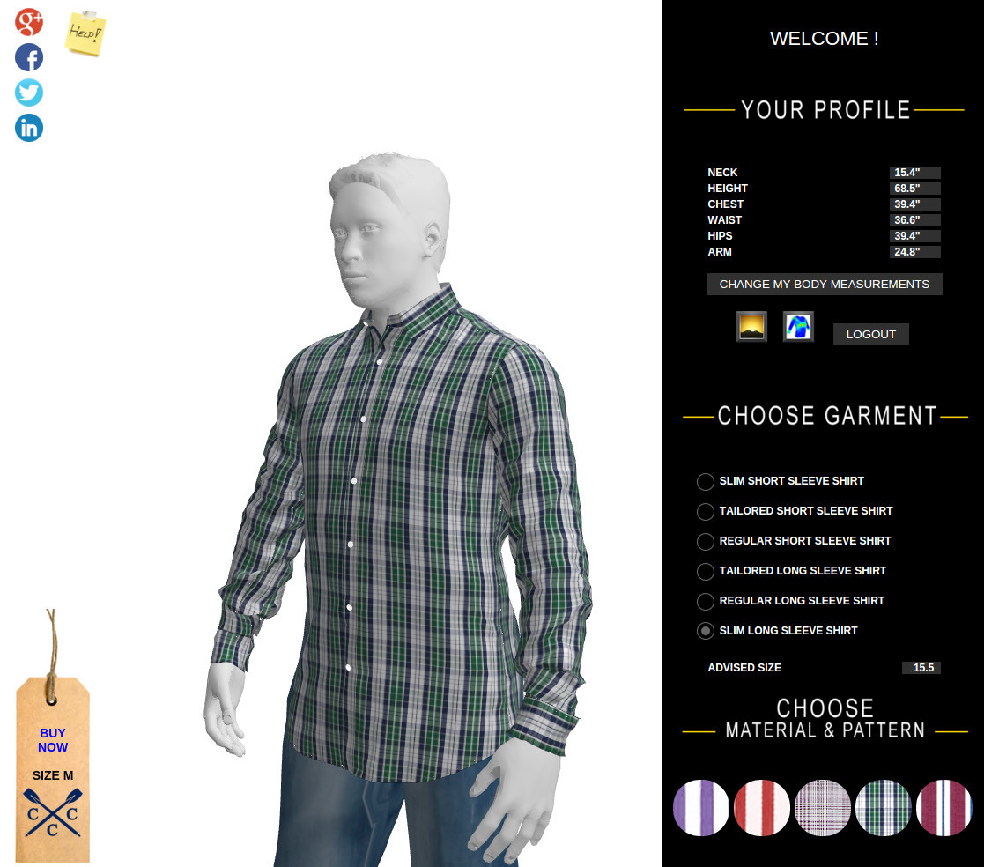
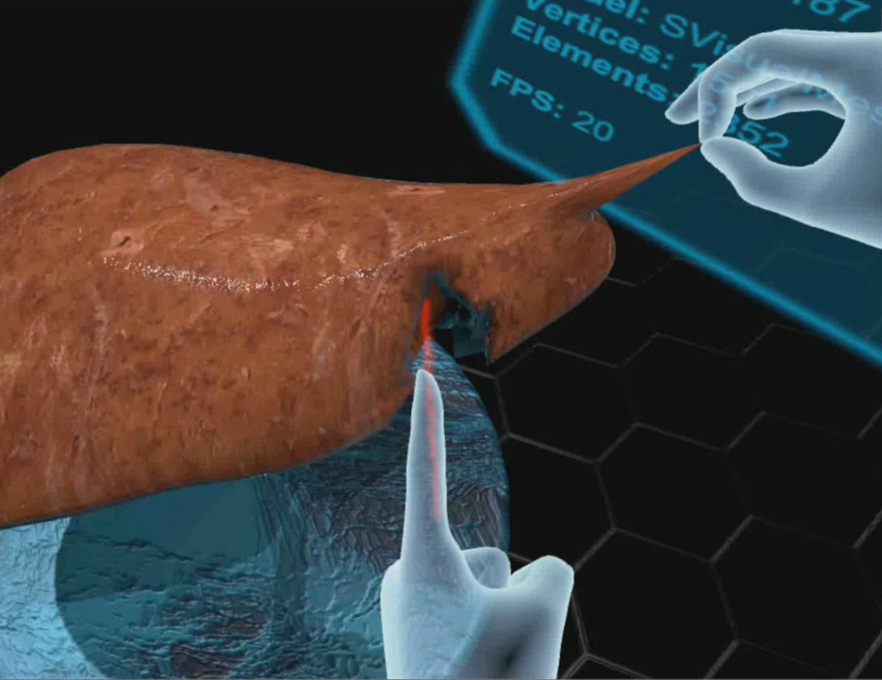


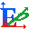



Round table
Speaker: Erik Pernod
15 years of experience in physical modeling
Dedicated to the improvement and use of SOFA as key element for innovations
2008-2011
2012-2016
2017
2018-2025

Slide 4
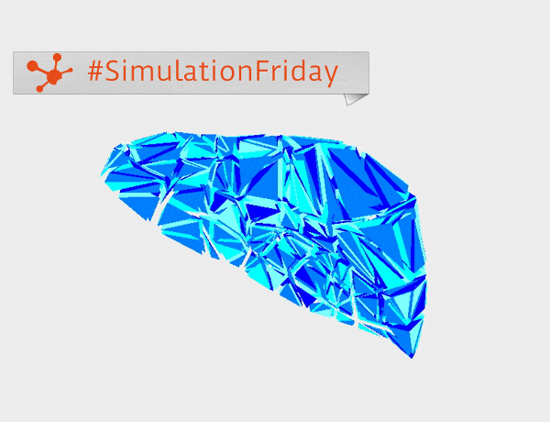
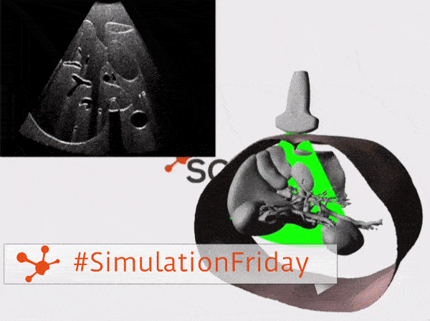
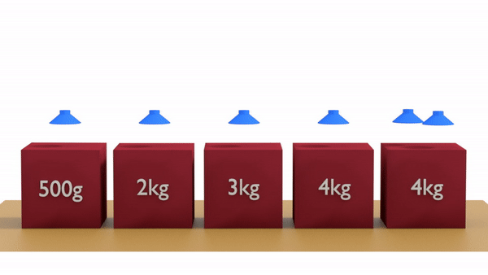
What is SOFA?
An interactive mechanical simulation tool
Implements algorithms for continuum mechanics
Model object deformations and their interactions
Suitable for creating digital twins
Application fields
Medicine
surgical training
preoperative planning & intraoperative guidance
Robotics
test and create new control methods
design a new generation of robots
BioMechanics

Slide 5
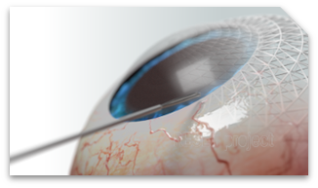
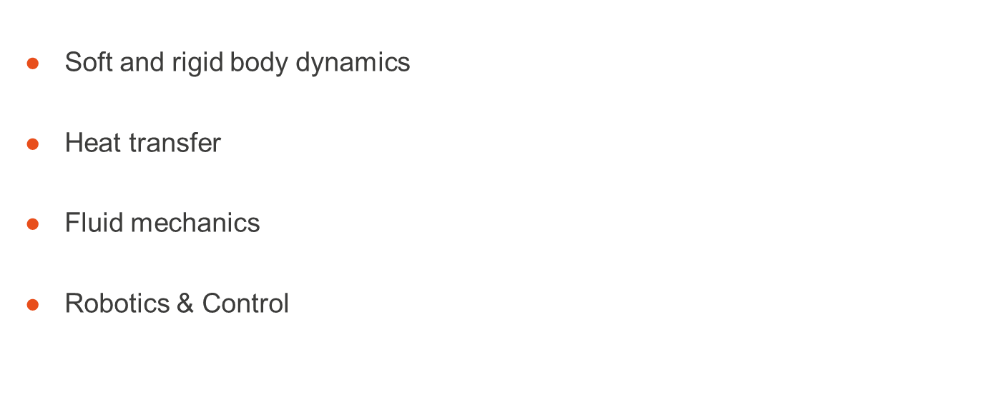
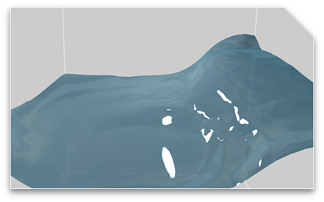
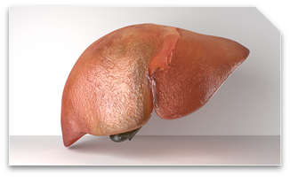
Multiphysics simulation

Slide 6
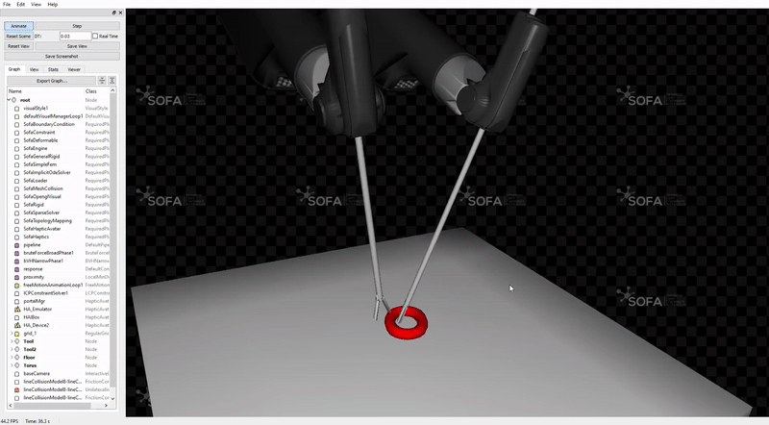
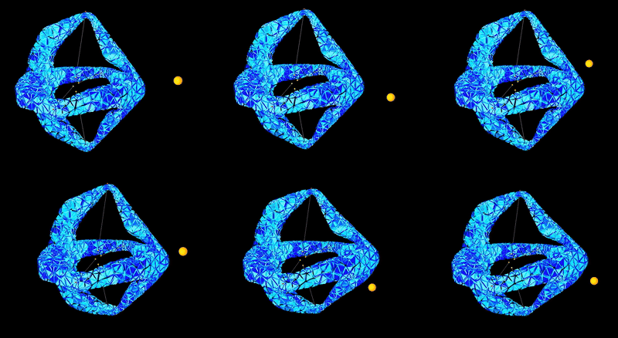
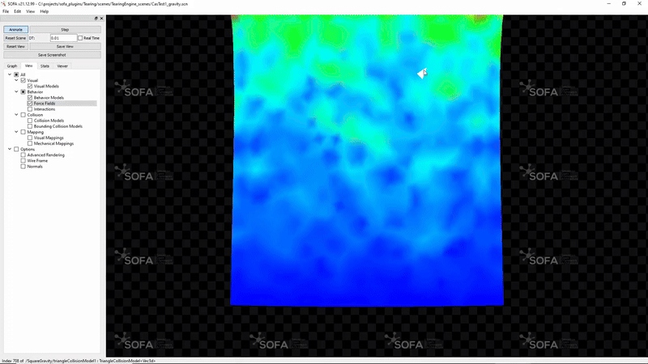
Why choosing SOFA?
Flexible
Ease design and prototyping of simulation
Modular architecture
OpenCore with plugins: activate / deactivate features
Interactive
User interactions to take into account
Enclose SOFA in optimization loops, learning
Dynamic simulation updates

Slide 7

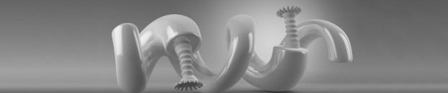
Community and project governance
Notes:
International community
Contribution management, CI
Governance committees
Roadmap + release

Slide 8

An open-source project
Being the open-source reference for
interactive and real-time applications
Arose from research back in 2006 at
Need of a collaborative framework for physics simulation
Project definition

Slide 9
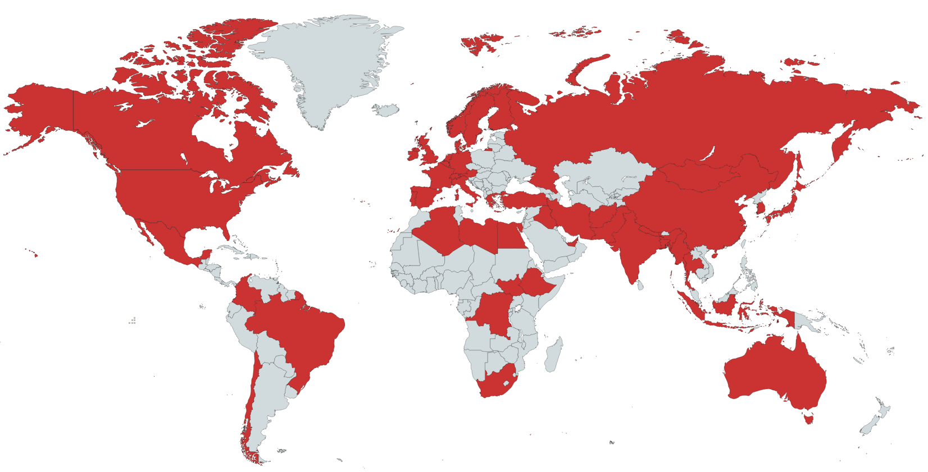
Our international community
Thriving community
+140 daily SOFA-based developers
+500 regular users
+700 monthly downloads
Driving innovation and collaboration
12 startups created since 2009
80% academic community
Industrial partners: LN Robotics, InSimo, Caranx Robotics, Dassault, Essilor
Academic partners: Harvard, Stanford, Johns Hopkins University, ETH Zurich, Luxembourg University, JAIST (Japan) MIT

Slide 10
An open-source consortium
Gathers partners willing to share the costs related to the missions of
Coordination of the developments
Industrialization and maintenance
Animation and support to the community
Structure the ecosystem
Acting as a third-party and non-profit organization

Slide 11





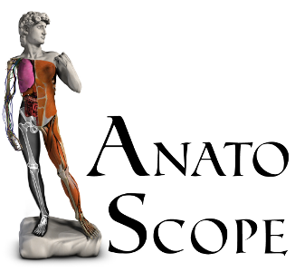

An open-source consortium
Strategic partners, steering the strategy of the project
Technical members, defining the roadmap based on contributions
Donors

Slide 12
Joint governance
Executive Committee (SEC)
Minimum once a year
Decide on the Consortium engineers priority tasks
Examine the Consortium's financial situation and take decisions accordingly
Decide the communication policy
Technical Committee (STC)
Twice a year : June & November
Vote the technical roadmap
Approve/modify SOFA development and contribution rules
Approve who is granted write access to the master reference code

Slide 13
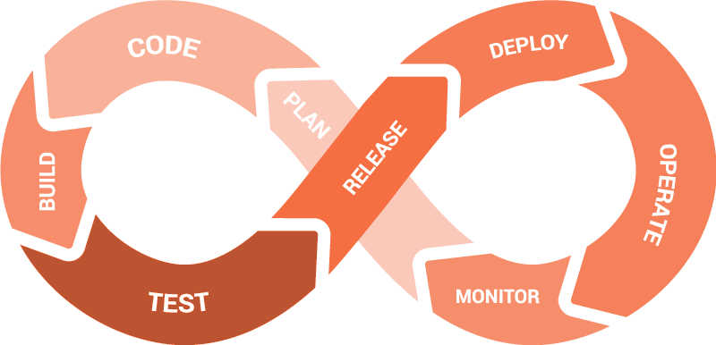

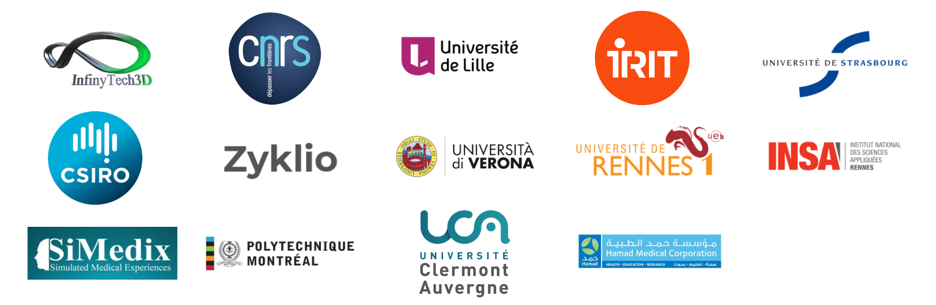


Development process
Robustness
Explicit contributing rules (GitHub)
Explicit review process (GitHub)
Continuous Integration (CI) : regression, unit and feature tests
Stable releases every 6 month → regular releases (v24.12)
Foster contributions from external contributors

Slide 14
Development process
Robustness
Explicit contributing rules (GitHub)
Explicit review process (GitHub)
Continuous Integration (CI) : regression, unit and feature tests
Stable releases every 6 month → regular releases (v24.12)
Constant industrialization
Improve code stability and quality
Document
Bug tracking

Slide 15
Let’s discover the software project

Slide 16


Software architecture
Code structure: OpenCore
Stable core written in C++ under LGPL-v2.1 (regular releases)
Coming with Python bindings
Development of plugins (free-to-define licence)
Notes:
Licence LIBRE
Liberté de … télécharger…
Capitalisation du savoir
Non diffusive! !

Slide 17



Software architecture
Code structure: OpenCore
Stable core written in C++ under LGPL-v2.1 (regular releases)
Coming with Python bindings
Development of plugins (free-to-define licence)
Multi-platform
Documentation
User online documentation → sofa-framework.org/doc
API documentation → sofa-framework.org/api
Open forum → github.com/sofa-framework/sofa/discussions

Slide 18
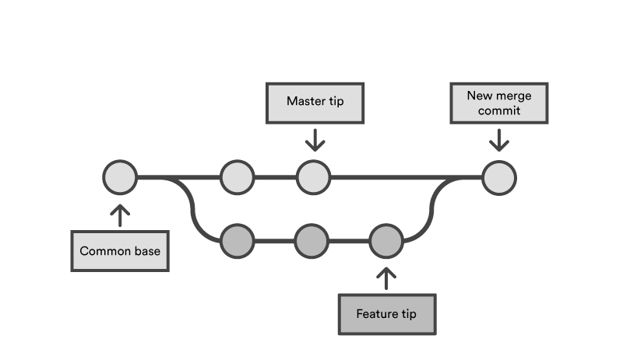
Versioning of sources
Relying on Git versioning system
Hosted on GitHub
https://github.com/sofa-framework/sofa/
Start with GitHub
Create your fork
For your development project, work in branches
Keep your master branch up-to-date regularly

Slide 19
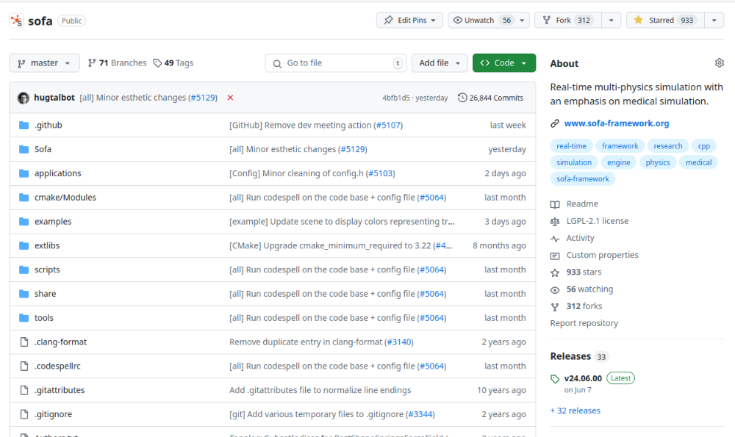
SOFA architecture
Programmation by component: one C++ classes = one task
Level of abstraction defining base classes : common ground
You can also add totally new types : must inherit from BaseObject
Contains all physical models, algorithms and simulation mechanisms
https://github.com/sofa-framework/sofa
Star * the project to follow and support us

Slide 20
SOFA architecture
Programmation by component: one C++ classes = one task
Level of abstraction defining base classes : common ground
You can also add totally new types : must inherit from BaseObject
Contains all physical models, algorithms and simulation mechanisms
Sofa/framework/ → no implementation, only abstract classes = API
Sofa/Component/ → implementation of models and algorithms
examples/Component/
applications/plugins/

Slide 21

How to get SOFA?
Compile SOFA
Checkout the sources
Configure with Cmake
Build (using make, ninja or others)
Documentation
Download the binary version (pre-compiled)
sofa-framework.org/download
Note that stable binary version of SOFA is available: v24.12

Slide 22
SOFA main principles
Notes:
Hands-on

Slide 23
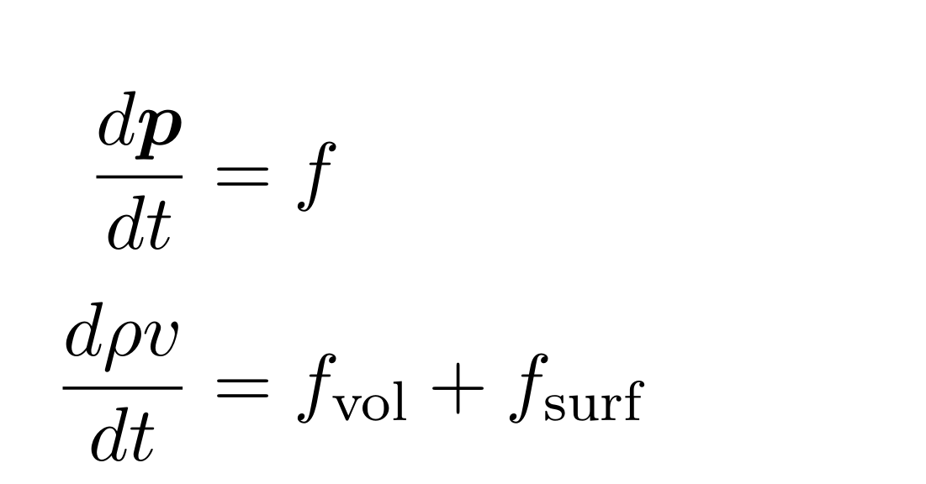
Solid mechanics
Historical field of application in SOFA
Classical (Newtonian) mechanics
Motion of bodies under external & internal forces
Rigid = no internal force = no deformation
Elasticity = return to rest shape after stresses
Visco-elasticity = elastic material with damping
Plasticity = permanent deformation after stress
Thermoplasticity = coupling between mechanical and thermal laws
Notes:
M: mass matrix, coupled with acceleration (lumping -> diagonal)
D: damping matrix, coupled with velocity (usually approximated)
K: stiffness matrix, coupled with position (linear or non-linear)
Evolution law (Newton)
Models (mechanical law)
Numerical solutions (solvers : ODE-LinearS)

Slide 24
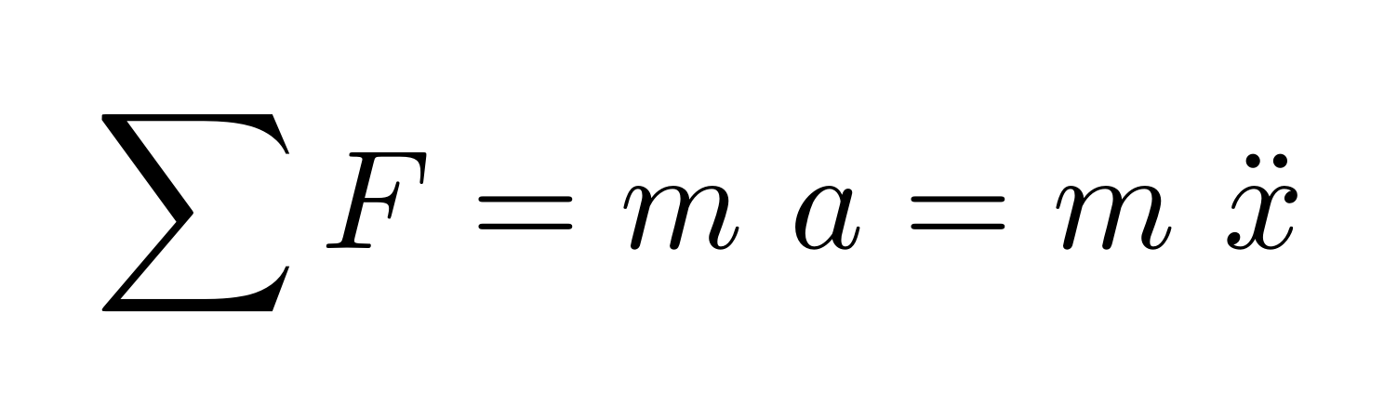
Solid mechanics
Historical field of application in SOFA
Classical (Newtonian) mechanics
Motion of bodies under external & internal forces
Rigid = no internal force = no deformation
Elasticity = return to rest shape after stresses
Visco-elasticity = elastic material with damping
Plasticity = permanent deformation after stress
Thermoplasticity = coupling between mechanical and thermal laws
Notes:
M: mass matrix, coupled with acceleration (lumping -> diagonal)
D: damping matrix, coupled with velocity (usually approximated)
K: stiffness matrix, coupled with position (linear or non-linear)
Evolution law (Newton)
Models (mechanical law)
Numerical solutions (solvers : ODE-LinearS)

Slide 25
Solid mechanics
Historical field of application in SOFA
Classical (Newtonian) mechanics
Motion of bodies under external & internal forces
Rigid = no internal force = no deformation
Elasticity = return to rest shape after stresses
Visco-elasticity = elastic material with damping
Plasticity = permanent deformation after stress
Thermoplasticity = coupling between mechanical and thermal laws
→ Rigid particle
→ Deformable liver
Notes:
M: mass matrix, coupled with acceleration (lumping -> diagonal)
D: damping matrix, coupled with velocity (usually approximated)
K: stiffness matrix, coupled with position (linear or non-linear)
Evolution law (Newton)
Models (mechanical law)
Numerical solutions (solvers : ODE-LinearS)

Slide 26
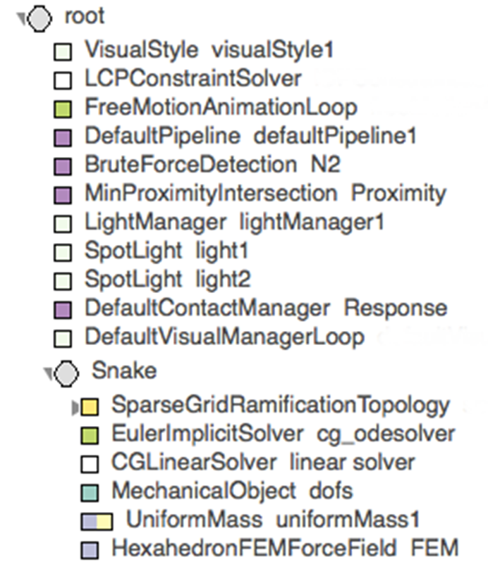
Scene Graph
Simulation described as a graph (Direct Acyclic Graph, i.e. generalized hierarchy)
Composed of nodes
Nodes contain Components
Components have parameters: Data

Slide 27
Scene Graph
Simulation described as a graph (Direct Acyclic Graph, i.e. generalized hierarchy)
Composed of nodes
Nodes contain Components
Components have parameters: Data

Slide 28
Scene Graph
Simulation described as a graph (Direct Acyclic Graph, i.e. generalized hierarchy)
Composed of nodes
Nodes contain Components
Components have parameters: Data
Data can be linked together ( input=@dofs.value )
Described using XML or Python

Slide 29
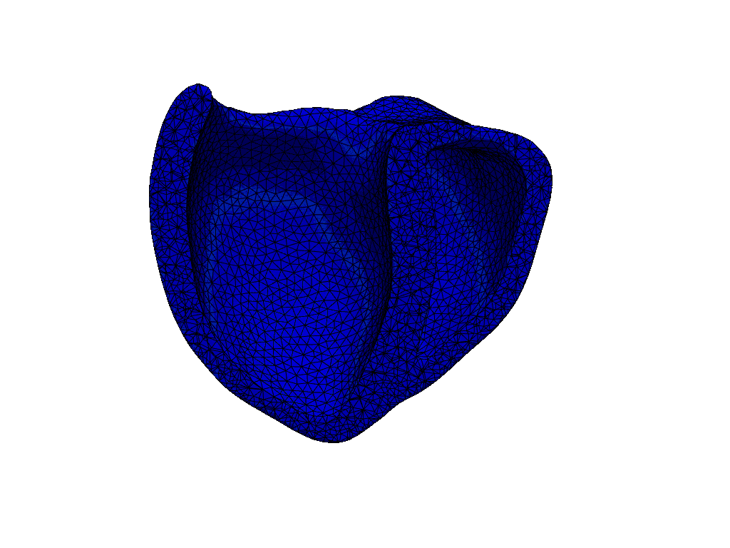
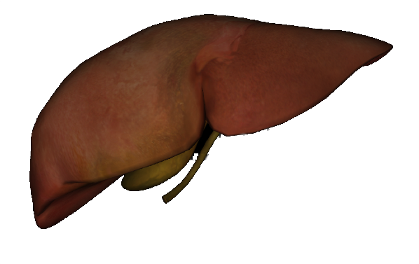
Scene Graph
Root
AnimationLoop
Heart
Liver
DOF
FF
M
Solvers
DOF
FF
M
Solvers - integration scheme (ODE) - linear solver

Slide 30
Scene Graph (XML format)
<Node name="root" dt="0.01" gravity="0 0 0">
<Node name="Liver">
<EulerImplicitSolver name="EulerImplicit_scheme" />
<CGLinearSolver name="CG" iterations="200" tolerance="1e-09"/>
<MechanicalObject template="Vec3d" name="myLiverDOF" position="..." />
<MeshMatrixMass totalMass="1" />
<TetrahedronFEMForceField name="LinearElasticity" youngModulus="1e7" />
</Node>
<Node name="Heart">
<EulerImplicitSolver name="EulerImplicit_scheme" />
<CGLinearSolver name="CG" iterations="200" tolerance="1e-09"/>
<MechanicalObject template="Vec3d" name="myHeartDOF" position="..." />
<MeshMatrixMass totalMass="2" />
</Node>
</Node>

Slide 31
Scene Graph (XML format)
<Node name="root" dt="0.01" gravity="0 0 0">
<Node name="Liver">
<EulerImplicitSolver name="EulerImplicit_scheme" />
<CGLinearSolver name="CG" iterations="200" tolerance="1e-09"/>
<MechanicalObject template="Vec3d" name="myLiverDOF" position="..." />
<MeshMatrixMass totalMass="1" />
<TetrahedronFEMForceField name="LinearElasticity" youngModulus="1e7" />
</Node>
<Node name="Heart">
<EulerImplicitSolver name="EulerImplicit_scheme" />
<CGLinearSolver name="CG" iterations="200" tolerance="1e-09"/>
<MechanicalObject template="Vec3d" name="myHeartDOF" position="..." />
<MeshMatrixMass totalMass="2" />
</Node>
</Node>

Slide 32
1. Scene Graph (Python format)
import Sofa
import SofaRuntime
def createScene(rootNode):
rootNode.dt=0.01
rootNode.gravity=[0, 0, 0]
liverNode = rootNode.addChild("Liver")
liverNode.addObject(EulerImplicitSolver)
liverNode.addObject('CGLinearSolver', iterations="200", tolerance="1e-09"...)
liverNode.addObject('MechanicalObject', template="Vec3d", name="myLiverDOF", position="...")
liverNode.addObject('MeshMatrixMass', name="mass", totalMass="1" )
liverNode.addObject('TetrahedronFEMForceField', name="LinearElasticity", youngModulus="1e7")
heartNode = rootNode.addChild("Heart")
heartNode.addObject(EulerImplicitSolver)
heartNode.addObject('CGLinearSolver', iterations="200", tolerance="1e-09"...)
heartNode.addObject('MechanicalObject', template="Vec3d", name="myHeartDOF", position="...")
heartNode.addObject('MeshMatrixMass', name="mass", totalMass="2" )

Slide 33
Scene Graph
Root
AnimationLoop
AnimationLoop
Heart
Liver
DOF
FF
M
solver
DOF
FF
M
solver

Slide 34
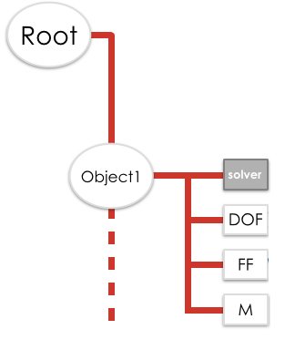
AnimationLoop and Visitor
AnimationLoop
Compulsory in a simulation
Rules and orders the simulation into steps. One time-step performs:
Collision detection
Constraint resolution
Solving the mechanical matrix system
At each time-step, Visitors (C++ pattern) browse the graph:
Graph traversal = traversing each component
Specific visitor triggers specific functions in components (ex: accumulateForce → addForce() )

Slide 35
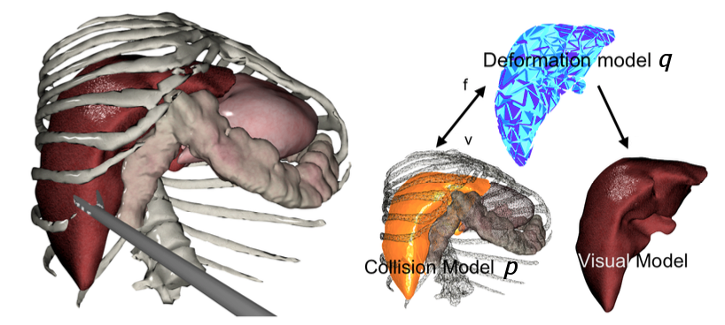
Mapping
Each object can have several models in SOFA
Mechanical model
Collision detection model
Visual model

Slide 36
Mapping
Each object can have several models in SOFA
Mechanical model
Collision detection model
Visual model
Each model can rely on a different topology
Correspondence between these models is a Mapping!

Slide 37
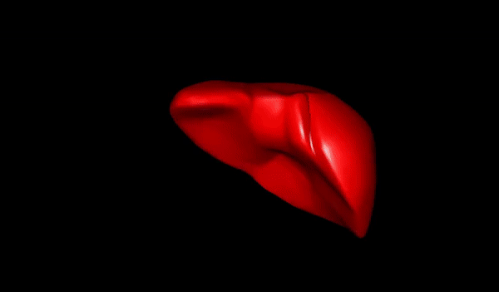
Mapping

Slide 38
SOFA features
Notes:
Core features
Plugins / community + reminder license
Hands-on

Slide 39
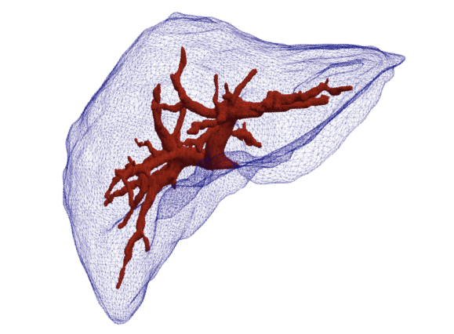
Loading geometries - MeshLoaders
Discretization in space using the Finite Element Method
Mesh are a required input: volumetric, surface and beam elements
Using mappings, different topologies can be used for each representation (mechanics, visual, collision detection)

Slide 40
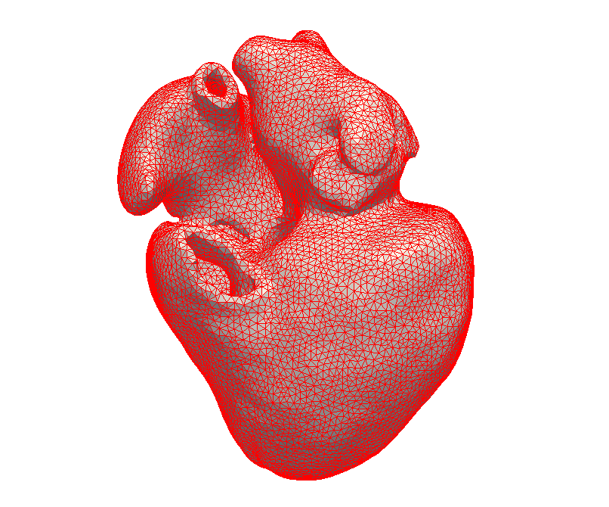
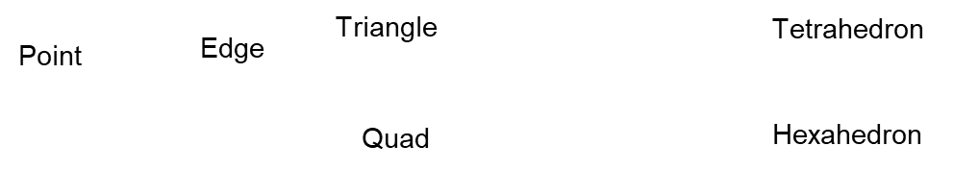
Topology
Describes the geometry
Discretization of space in elements (DOF): definition of connectivity
Load topologies in your simulation

Slide 41
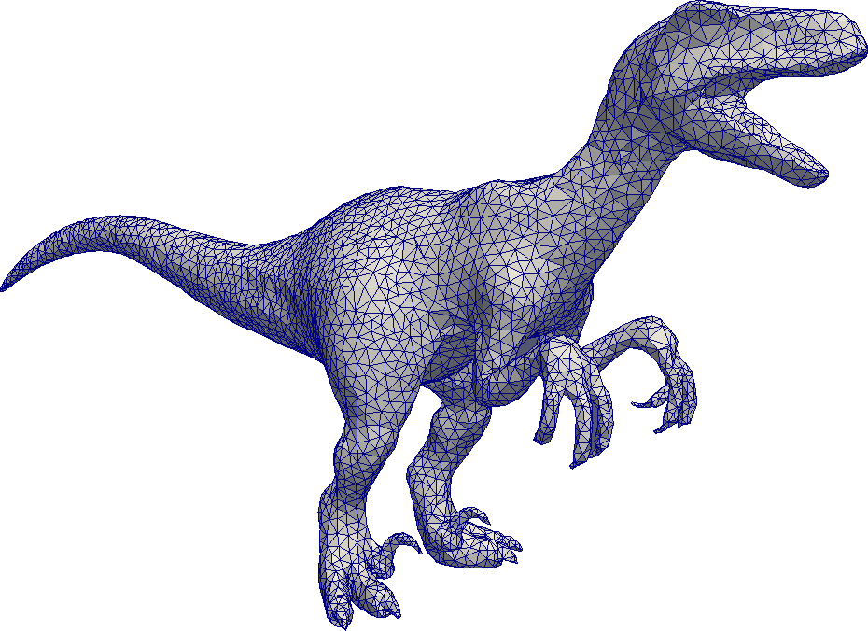
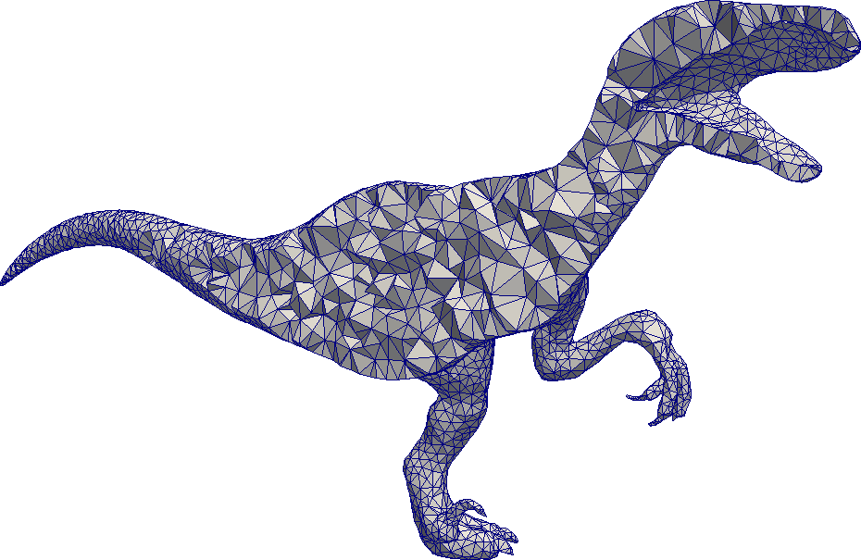
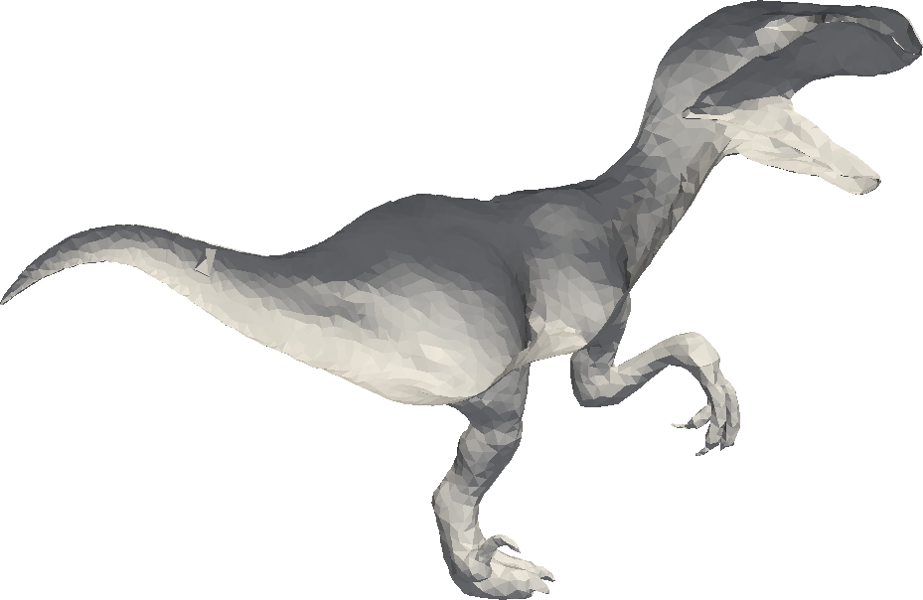
Topology
For each representation (mechanics, visual, collision detection), different topologies can be used
Mappings links them

Slide 42
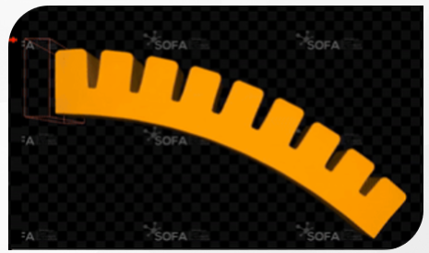
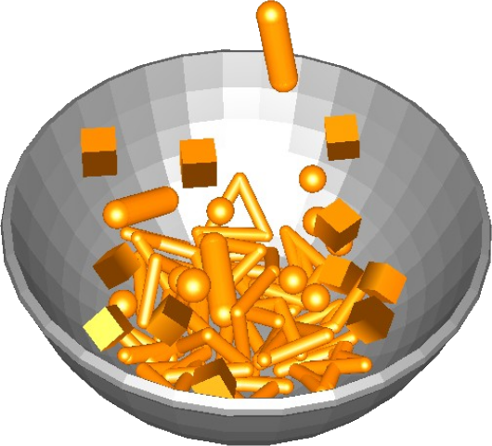
Solid mechanics
Material laws
Linear elasticity
Plasticity
Hyperelasticity
Damping : numerical or physical
Collision pipeline
Detection
Response
Integration schemes and linear solvers

Slide 43
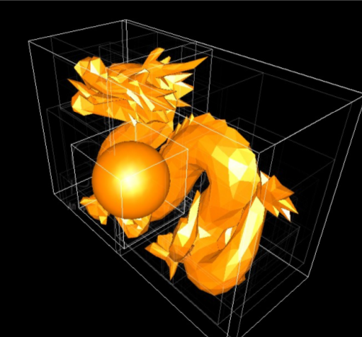
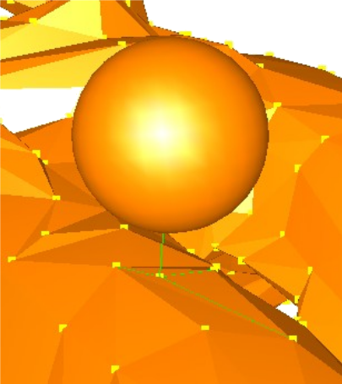
Collision pipeline
Detection
Broad phase checks to quickly exit if objects are far
Narrow phase detects contacts between primitives using proximity intersection
Response

Slide 44
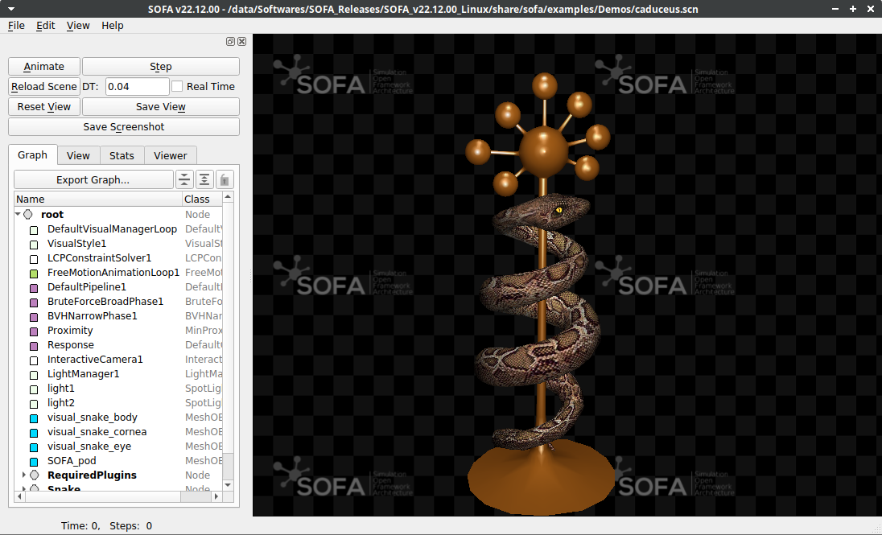
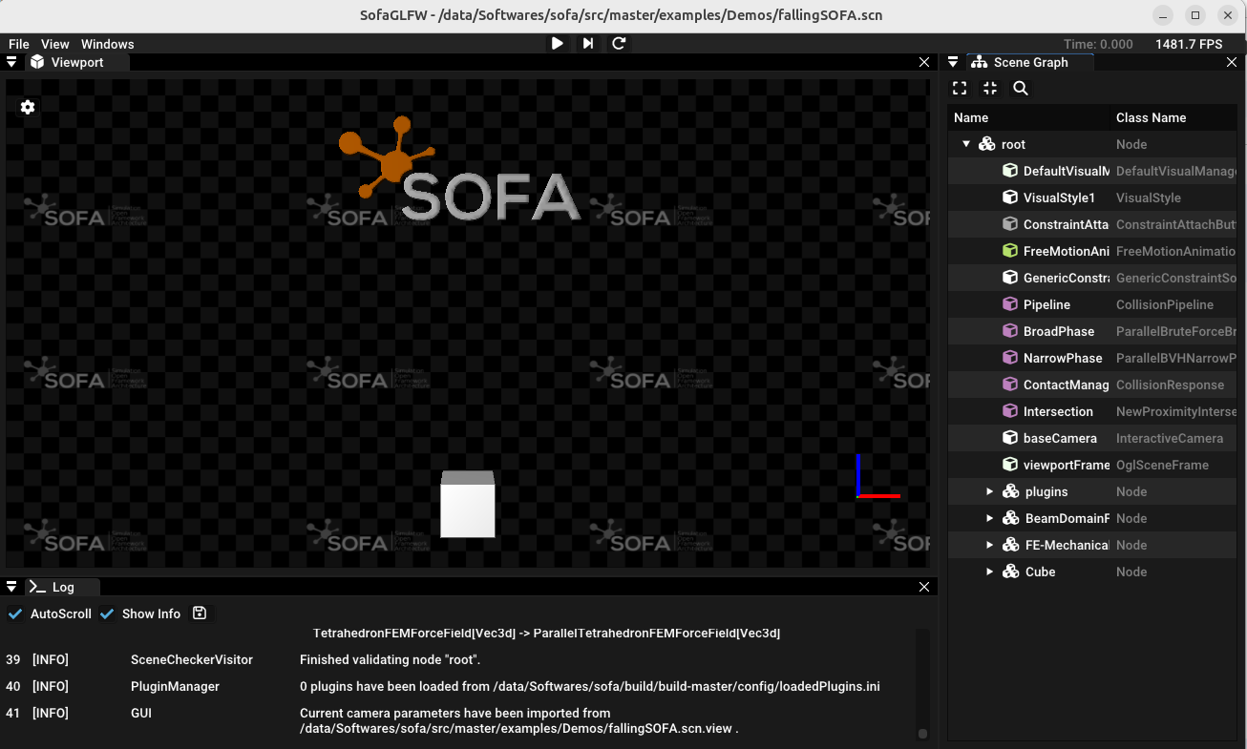
GUI runSofa
Build-in Graphical User Interface (GUI) is available
When running the SOFA executable ./runSofa

Slide 45
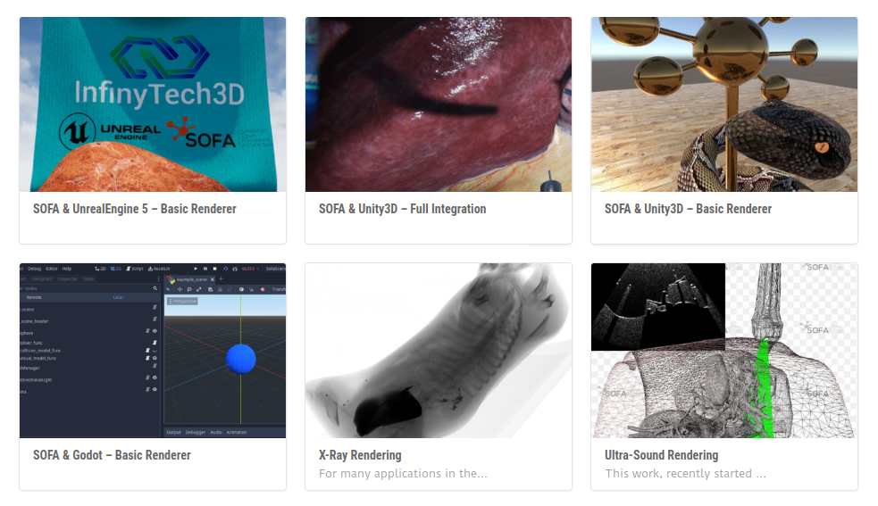
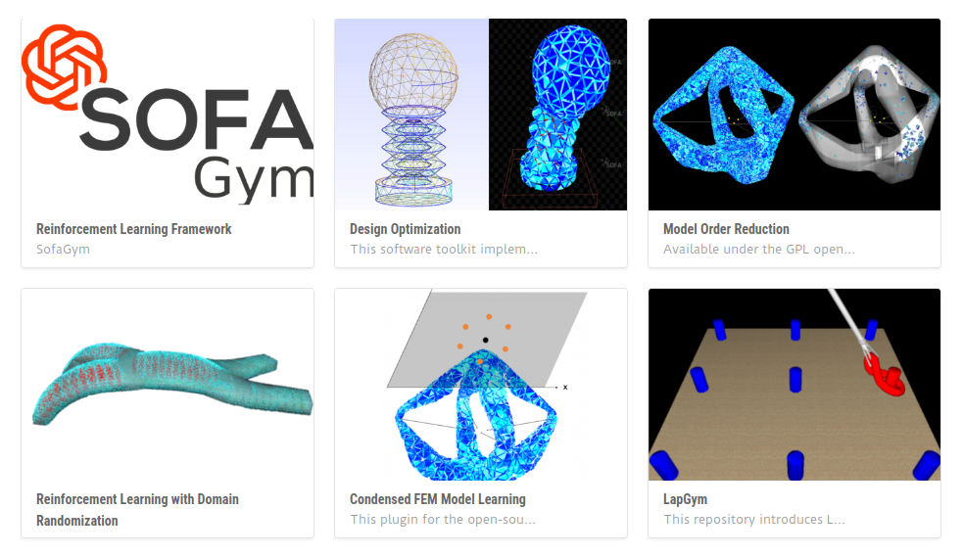
Plugins
Officially-maintained plugins available in SOFA releases
License of plugins is up to the plugin authors

Slide 46

SofaPython3: scripting in
As in XML, it allows for:
Fast prototyping
Create a scene without C++ skills
Dynamic modifications (data, component creation), interactions
Run your simulation for runSofa or python environment
Create new components as python class!
Official repository: https://github.com/sofa-framework/sofapython3/

Slide 47

SofaCUDA: GPU computing
Compatibility with CUDA GPUs
Activate GPU version of the C++ code
Only templates need to be changed (CudaVec3d)
Accelerate your own code

Slide 48
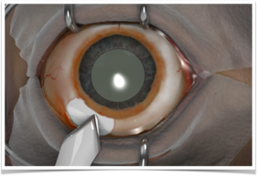
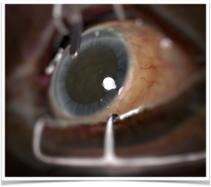
Interactive/haptic interfaces
Compatible with many devices
Geomagic
Falcon
Entact
Leap Motion
Follou laparoscopic devices
Haply Robotics
ForceDimensions

